Slide 1
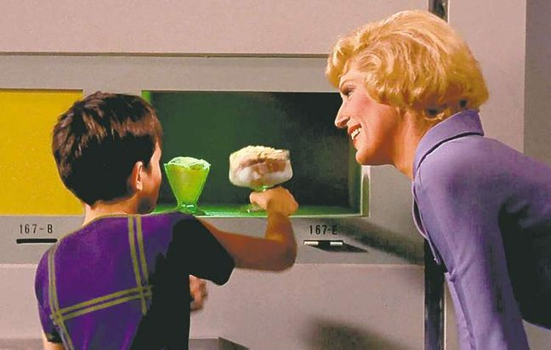
Bringing Drink Service into the “Smart” Age of Technology
Haley Currence - “Replicator”

Slide 2
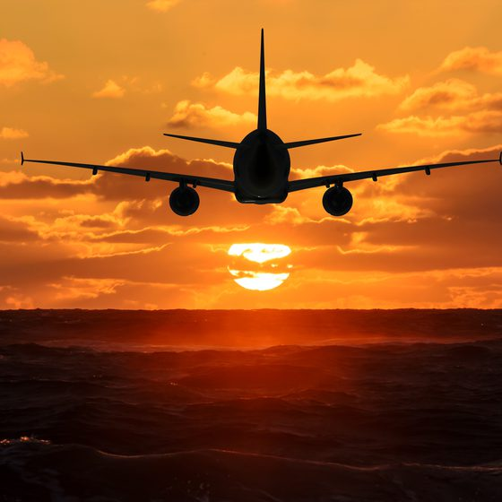
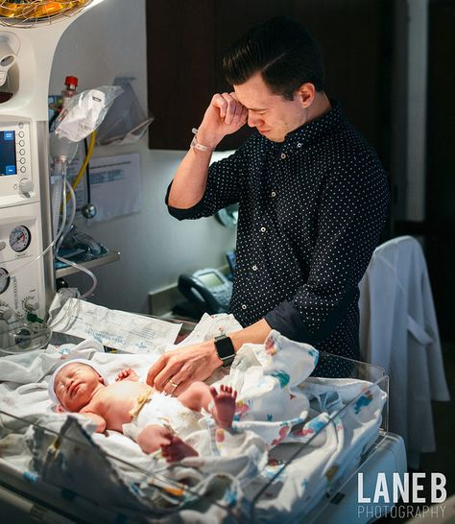
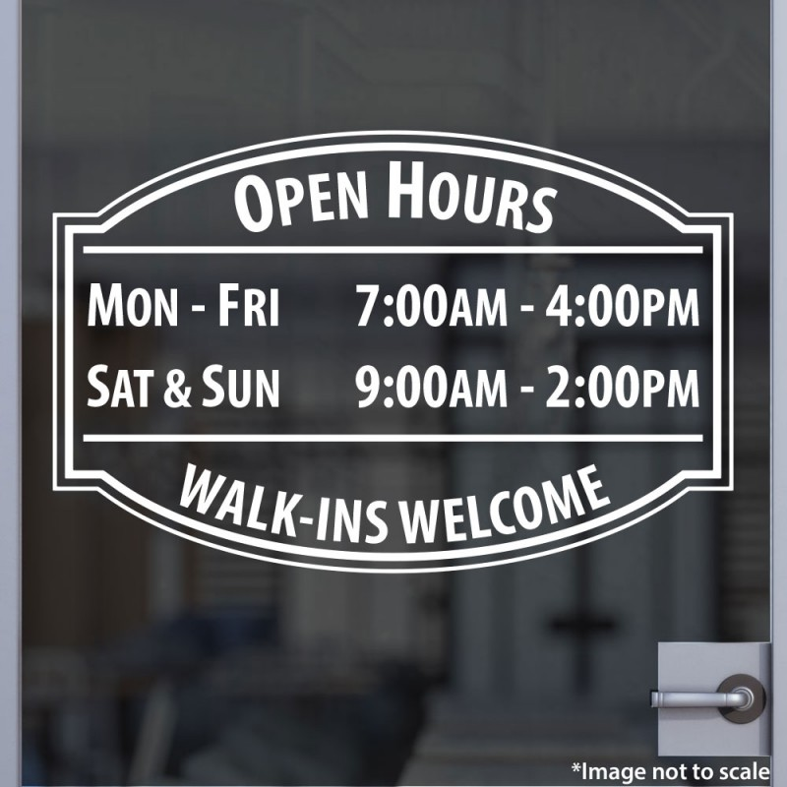
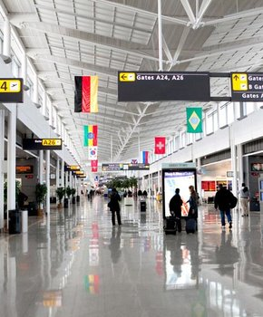
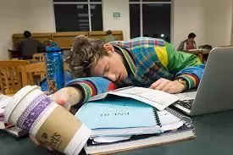
Haley Currence - “Replicator”
Notes:
“God I need a drink”, but specific drink services are not available
24 hour accessibility vs 9 hour a day,

Slide 3
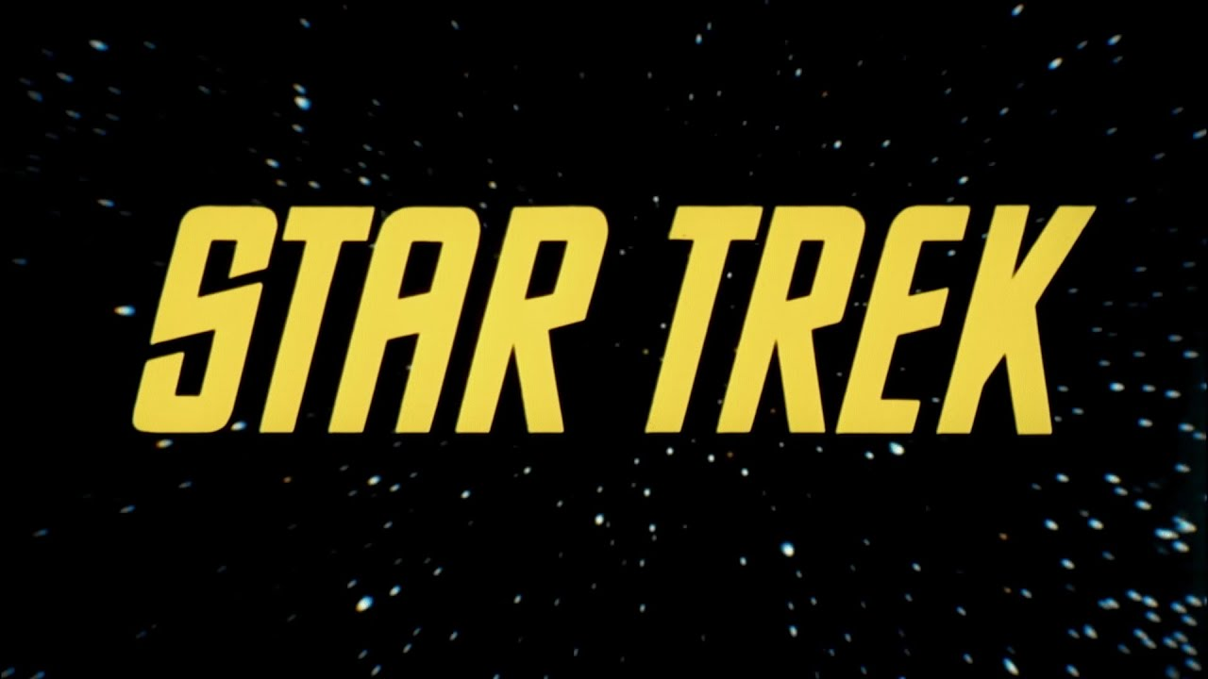
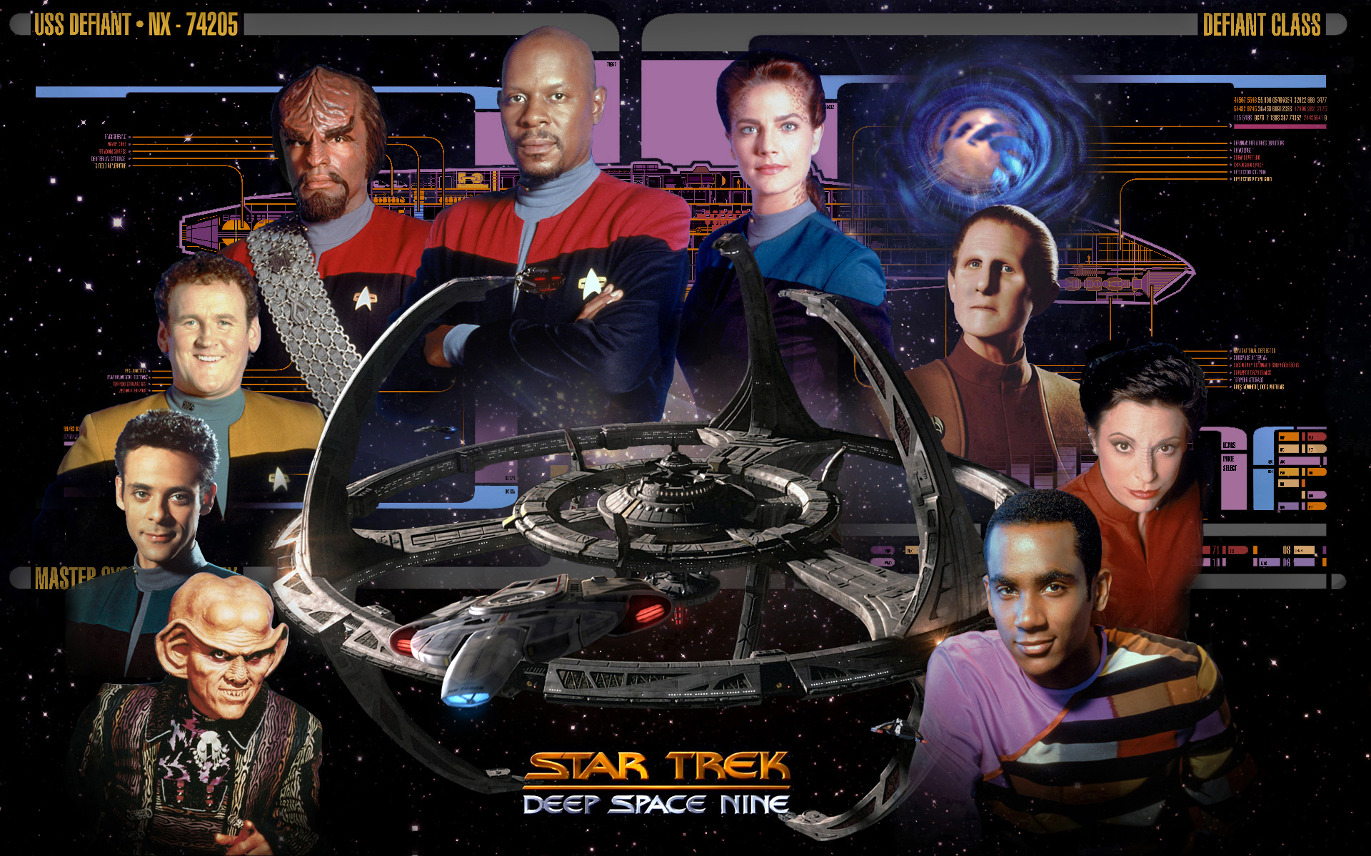
Haley Currence - “Replicator”
Notes:
Inspiration
Tinkering
Computer Science
Star Trek

Slide 4
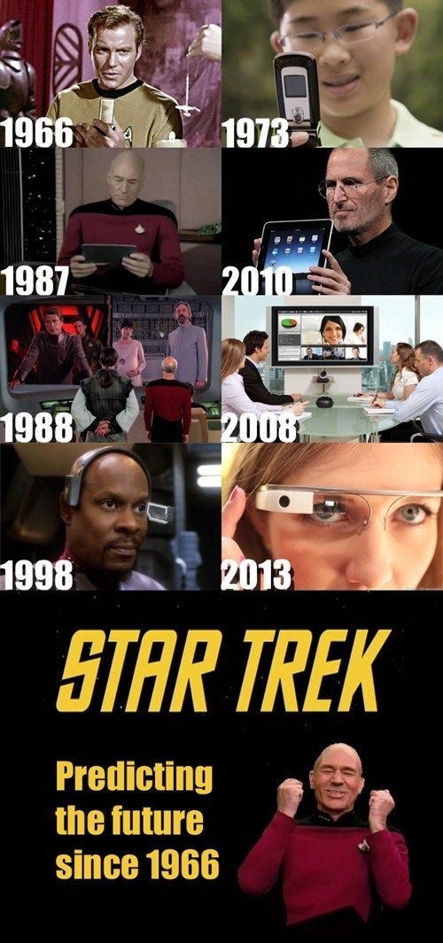
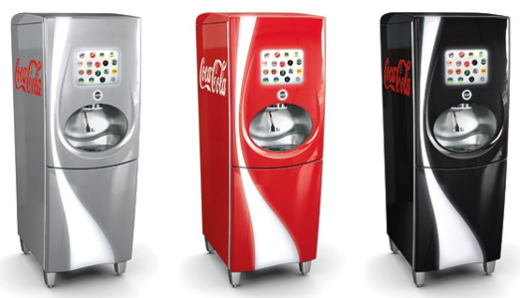
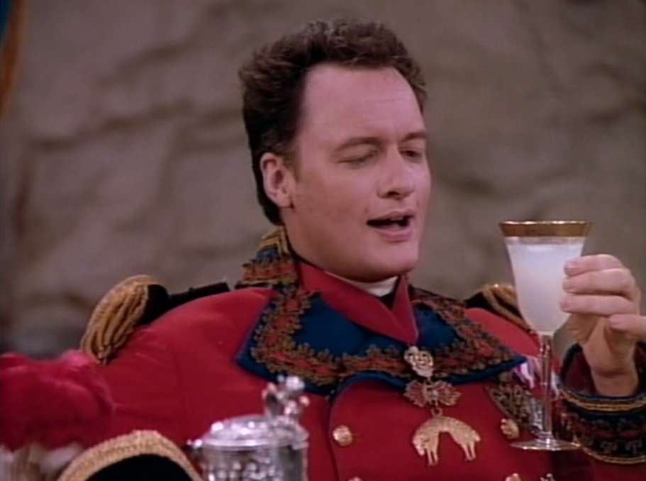

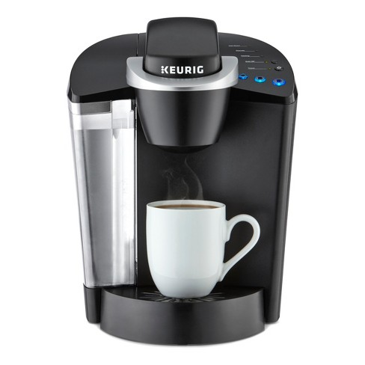
Haley Currence - “Replicator”
Notes:
Multitude of Inventions inspired by Star Trek
Using existing tech to develop a machine that provides a full spread of drink options

Slide 5
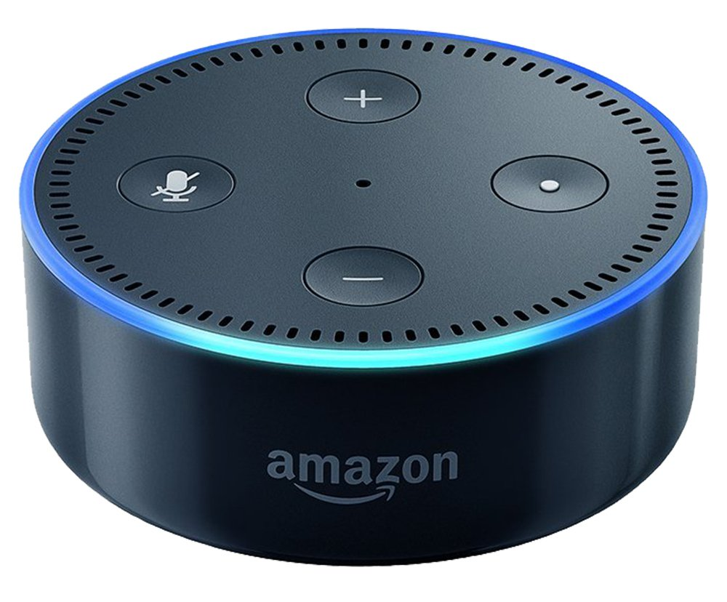
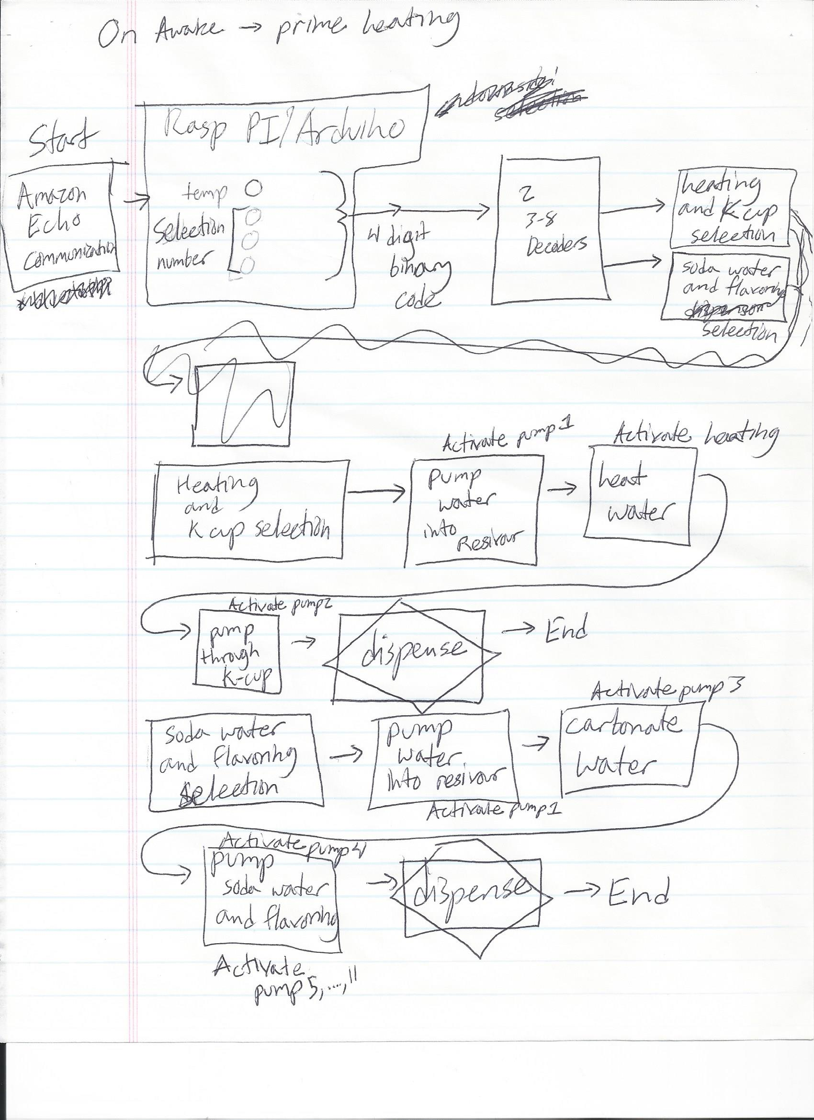
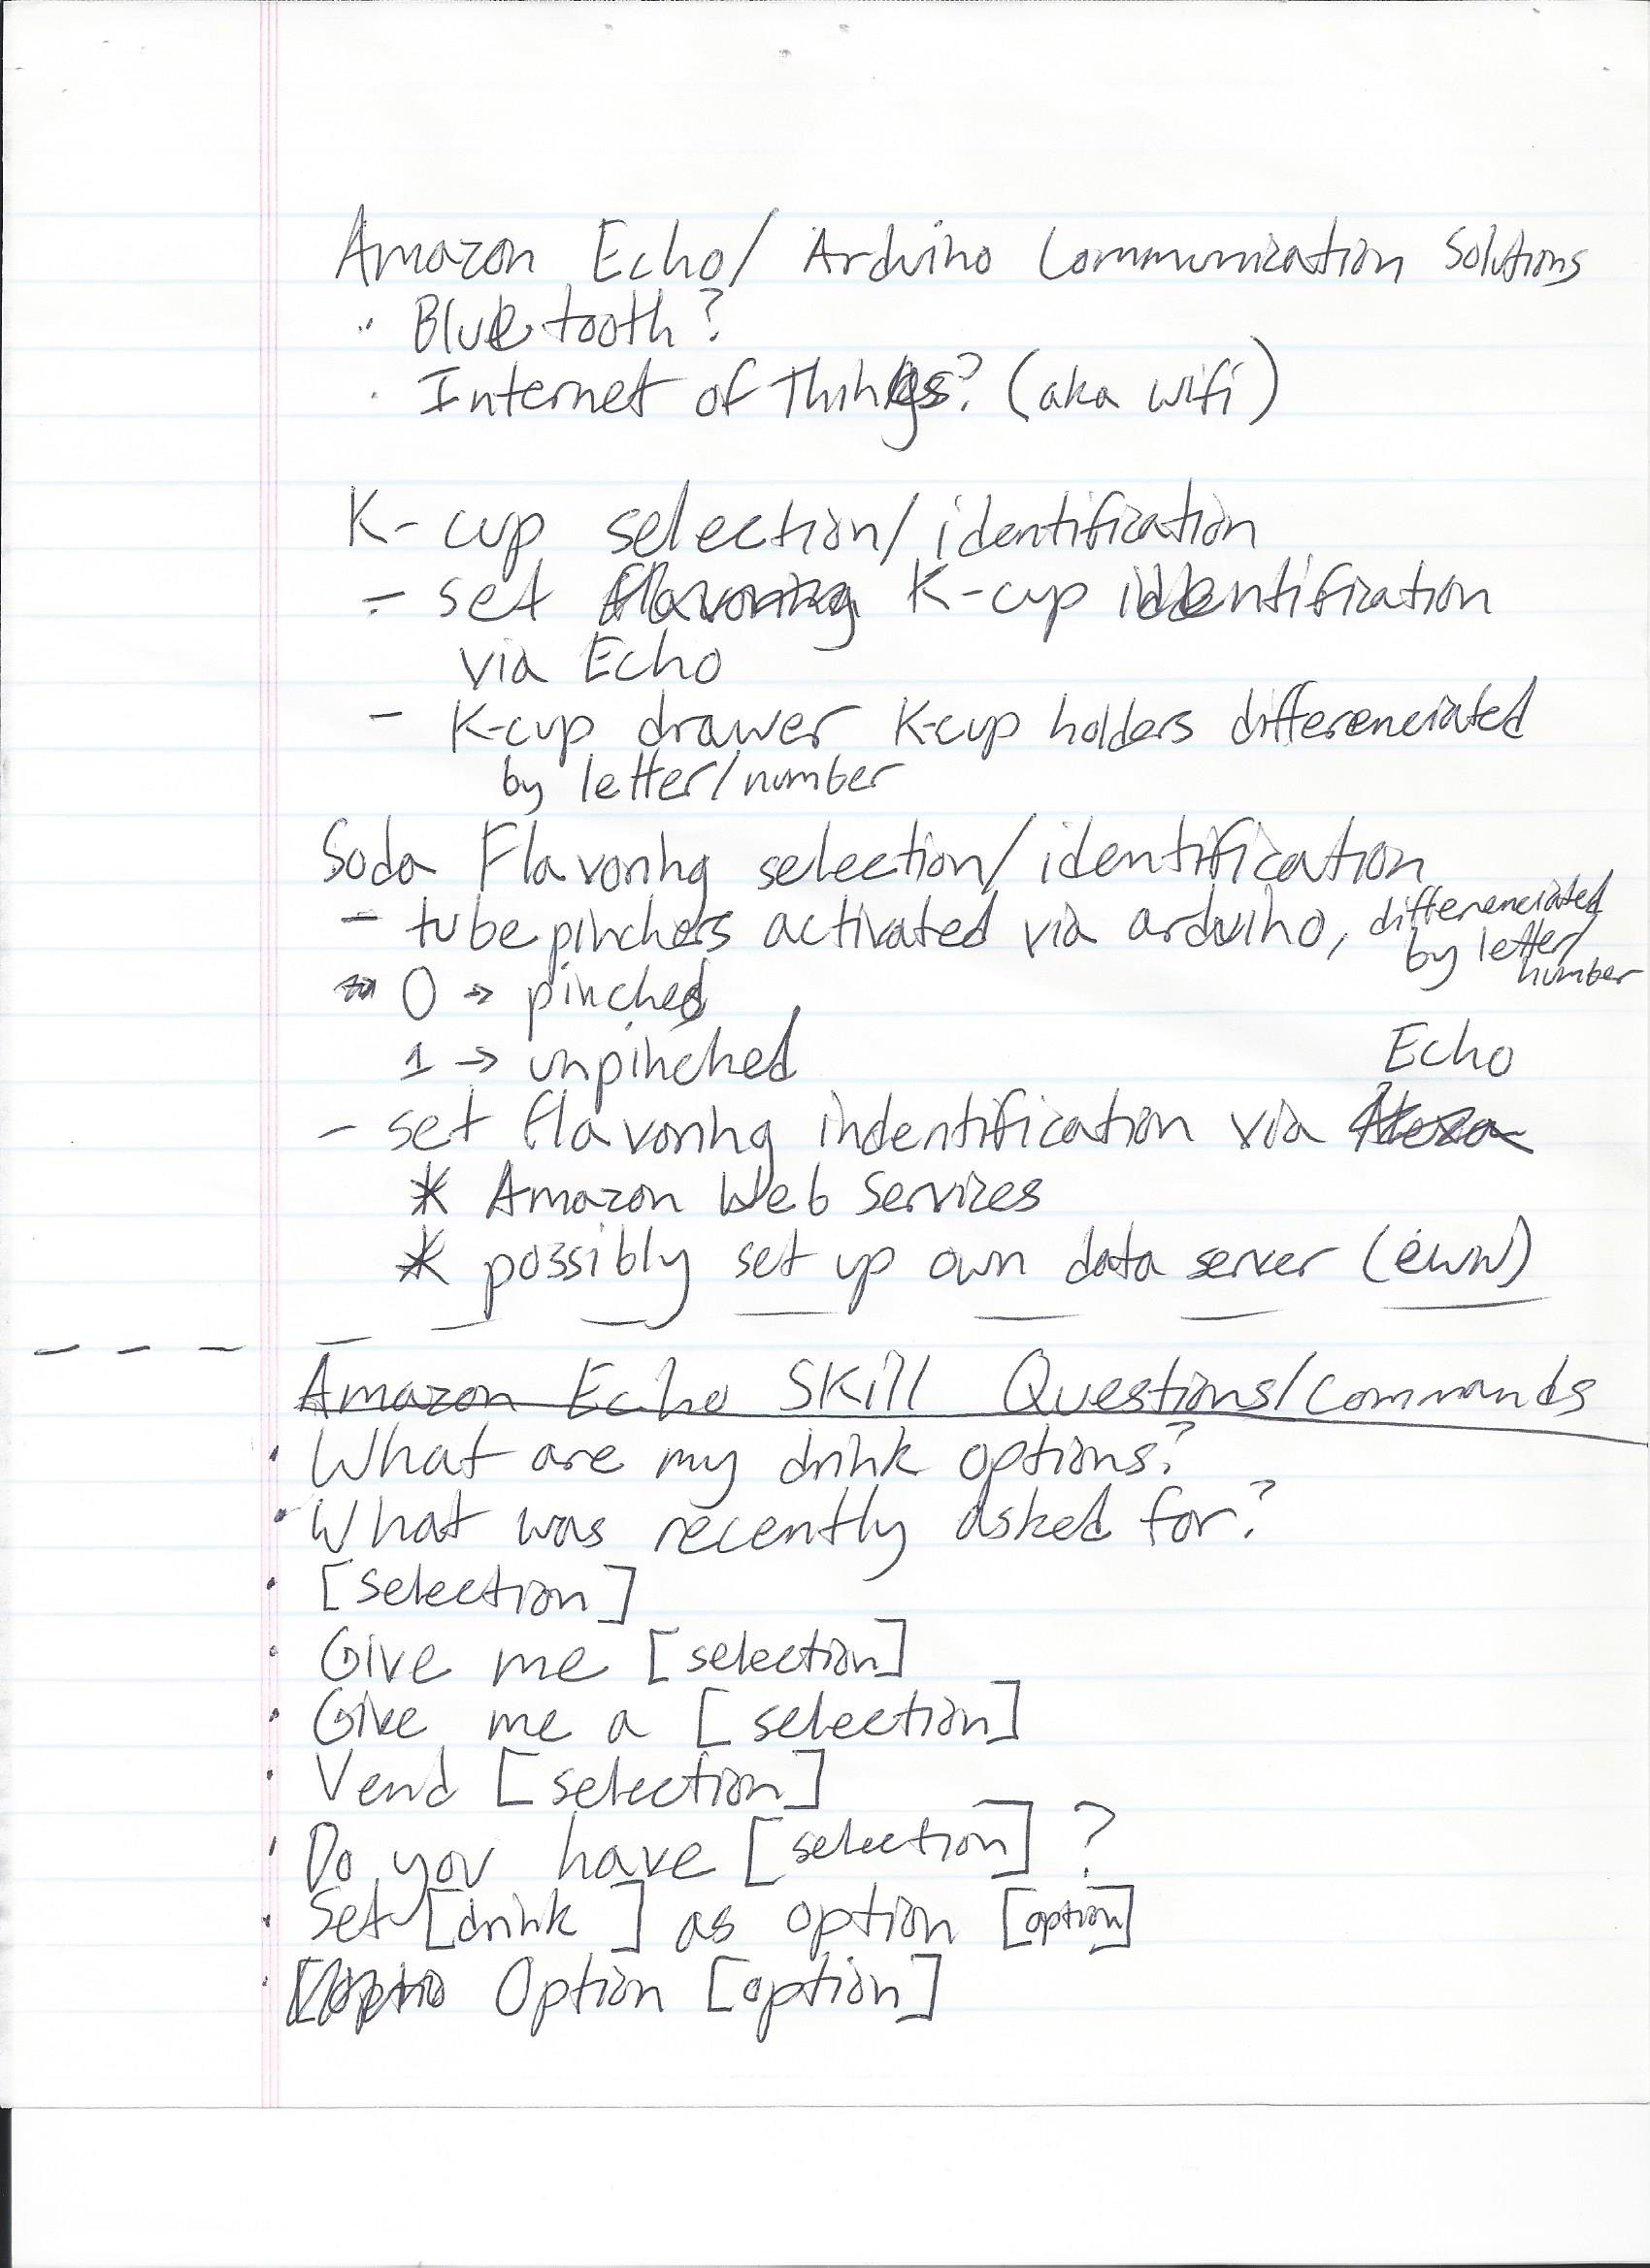

Current Stage: R&D
Haley Currence - “Replicator”

Slide 6
From Here On:
Drawing Advanced Designs
Continuing Research
World
Domination
Patenting my Idea
Finding Mentoring
Haley Currence - “Replicator”
Notes:
Target Market/Next Steps Timeline

